Slide 1
SURF 2024 - 1st Meeting
Ryan Hsieh 2024/05/23

Slide 2
AGENDA
Updates of Past Weeks
Informs
Optimization Model
IEEE Paper

Slide 3
Updates of Past Weeks
Meeting with Tom and Lori
Connection with IE Department Head Son
Website/Marketing
Sum-up of our achievements
Team Reconstruction
Future Directions (Four Sub-Teams)
Synthetic Data (GAN)
Forecasting (ML)
Optimization
Marketing (Website)
Future Directions (General)
Fall Research EXPO
SAS Optimization Competition (Waiting for confirmation)
SAS Curiosity Cup (2025 Spring)
SAS Hackathon (Data Analytic)
**Informs**
Blog Article on SAS
Informs Conference
Undergraduate Operations Research Prize
Progress of our Project
Progress of SURF Research
Enhance team's visibility and prestige
Goal of elite VIP team & enhance prestige
Webpage and LinkedIn page in Progress
New Marketing partner – Renee Chang

Slide 4

INFORMS

Slide 5
Real Time Pricing Optimization model

Slide 6
Sets
I = set of charging station (specific CS we do optimization)
𝟄{i₁, i₂, i₃, ….}
T = set of time periods (hourly)
𝟄{t₁, t₂, t₂, ….}
V = set of vehicles (specific brand or specific type of EVs)
𝟄{v₁, v₂, v₃, ….}
Different brand has diff power use
Type of EVs = SUVs, Sedans, Trucks, Buses etc.

Slide 7
Parameters
C_{it} = Cost of users to charge EVs at station i in time t
User decide the price ==> varies depend on demand of electricity or speed of charging
G_{it} = Impact of EVs on electric grid at station i in time t
R_{it} = Income of station i in time t
P_{max} = maximum price
P_{min} = minimum price
V_{i} = Number of Vehicles at station i
Δt_{it} = Time spent at station i in time t
{W₁, W₂, W₃} = Weight factors for 3 objectives
E_{max} = Maximum allowable impact on e-grid
Penalty = Penalty for exceeding the maximum allowable impact on e-grid
PL_{v} = Power level of vehicle v
PL_{min} = min power level use
PL_{max} = max power level use
W₁ = minimize total cost for users to charge their EVs
W₂ = minimize EVs' impact on e-grid
W₃ = maximize income for CS

Slide 8
Variables
P_{i}(t) = Price of charging at time t & station I
X_{itv} = Decision variable representing the charging status of EV v at station i in time t
Always stays 1 if we are only considering the scenario in CS

Slide 9
Objective Function w/ constraints
min Σi𝟄I Σt𝟄T Σv𝟄V {W₁*C_{it}(P_{i}(t)) + W₂*G_{it} - W₃*R_{it}(P_{i}(t)) + Penalty*max(0, G_{it}-E_{max}]} * X_{itv}
Time Spent at Station: Δt_{it} ≥ 0, 𝜵i 𝟄 I, t 𝟄 T
Price Constraint: P_{min} ≥ P_{i}(t) ≥ P_{max}, 𝜵i 𝟄 I, t 𝟄 T
E-Grid Impact: Σi𝟄I Σv𝟄V G_{it}*X_{itv} ≤ E_{max}, 𝜵t 𝟄 T
Power Level: PL_{min} ≤ PL_{v} ≤ PL_{max}, 𝜵v𝟄V

Slide 10
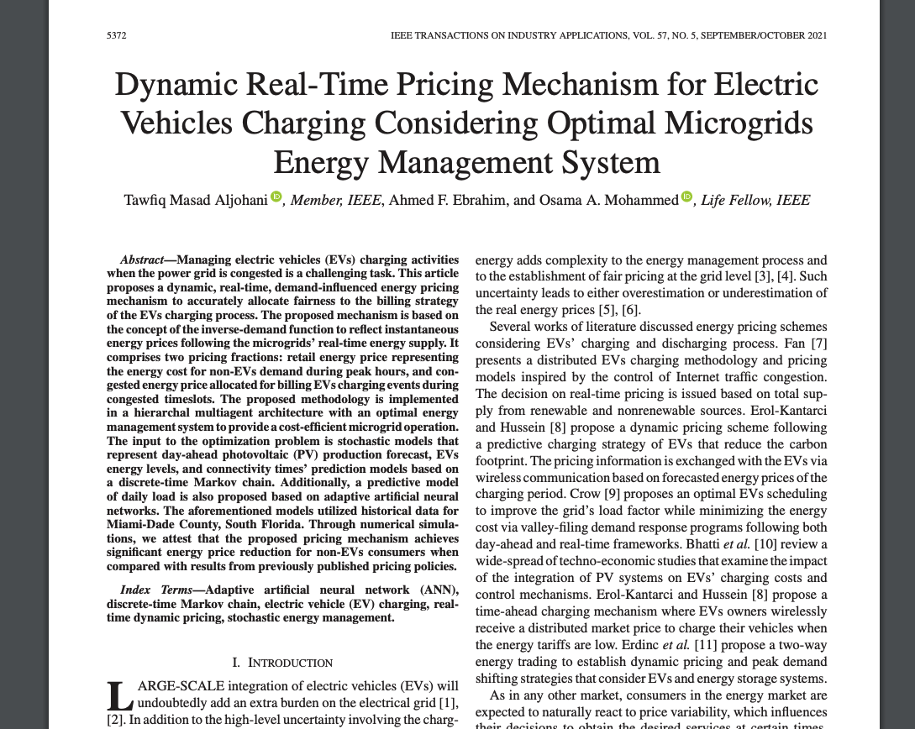
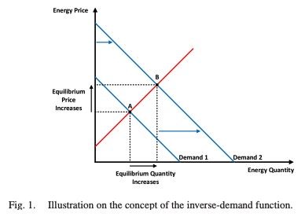
IEEE paper
Proposes : a dynamic, real-time, energy pricing mechanisms adopted w/ optimal EMS to offer balanced & fair energy consumption and billing
Unique Concept used : inverse-demand function
**Optimal EV's scheduling to improve grid's load factor while minimizing energy cost via valley-filling response program following both ^{1.}day-ahead & ^{2.} real-time frameworks

